Slide 1
Spring 2025-CSE332 Computer Organization and Architecture

Slide 2
Textbooks
Computer Organization and Design MIPS Edition, Fifth Edition: The Hardware/Software Interface, by David A. Patterson and John L. Hennessy, Publisher: Morgan Kaufmann; 5 edition
Computer Organization and Architecture (10th Edition) by William Stallings, Pearson Publisher: 10 edition, January 22, 2015.

Slide 3
Tests and Evaluation
Attendance and Attention: 5%
Quiz: 15% (best 3 quizzes will be counted)
Assignment: 10% (average of all)
Mid Term-1: 15%
Mid Term-2: 15%
Lab: 10%
Term Final: 30%
Grading: NSU standard

Slide 4
Students’ Comments: (please read carefully)
gives excess pressure which might put a bad impact and student might lose interest teaches a lot of things that we can't memorize at a time.
takes classes and quizzes on government holidays. Giving continuous pressures from day one is not good for our mental situation.
Exam questions are different and difficult than class lectures. exam questions are very difficult a great understanding is required to do good
too many exams. Almost everyday or every other day we had exam for this course which made it extremely painful and difficult for us to balance good grades in other courses.
the course focuses too much on slides and because slides are meant to be just the gist of information they were never adequate in creating the proper understanding in my case
teach so many thing on class but it's not present in the slide or you just add a single picture on the slide and then discuss too many stuff on the class. Now it's almost impossible for someone who miss the class to understand what he or she needs to study.
took countless class on problem solving at night. It is not possible for everyone to join as we have other courses too.
always gives slides or info before the exam night; it became quite hectic to get all the info; it's really too much to finish before the exam.
Worst. Not student friendly. If we have exam in tomorrow. His syllebus will be till today. That's very disappointing for us.
should state properly what he is lecturing about and what to do with it. He should make his lectures more lively. He teaches continuously and most of the students are clueless what they are doing and why they are doing. If the lectures were a bit more cheerful and the problems were stated perfectly this would have been a great course.
The teaching process is hectic. Unnecessary lengthy lectures. No specific syllabus before the exam. Students keep wondering if should they study this topic or not. This made the course very difficult to understand.
too much questions slides confused us what to read or not.
If sir were a character in the Marvel Cinematic Universe, his role might be- Night Owl: Runtime of a Lifetime. Takes too many classes at night, making it difficult for students with tuition to attend.
Sometime we don't understand what he is actually teaching.
He always takes an extra 5 to 10 minutes to finish class
Our teacher starts the class before the scheduled time and finishes 8-10 minutes late, which causes us to be late for our next class. Additionally, his teaching style is not engaging, as he gives nonstop lectures, making it difficult for us to concentrate.
Bad

Slide 5
What we will discuss…
Functional units and Interconnections
Define Computer Architecture & Computer Organization
How computers work?
How computers run programs?
How to assess performance of a computer?
How to improve performance of a computer?

Slide 6
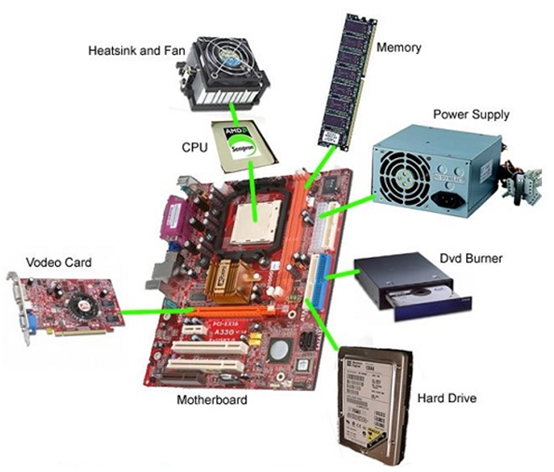

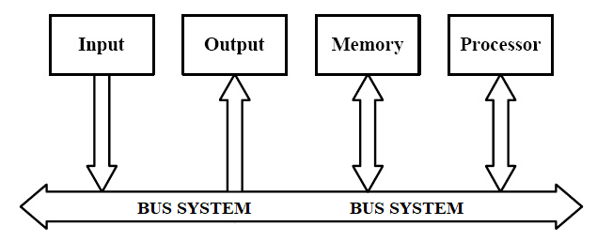

Slide 7
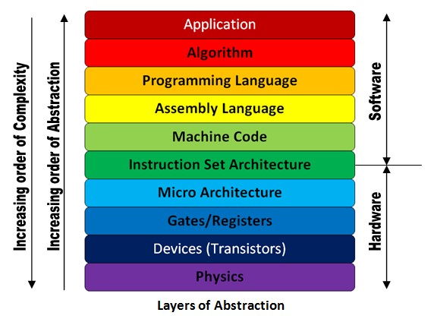
Representing computer Architecture:
schematic diagram: easy to explain interconnection and operation

Slide 8
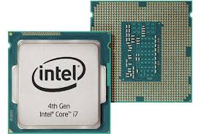
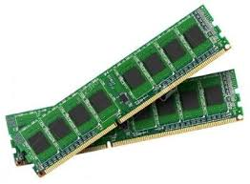
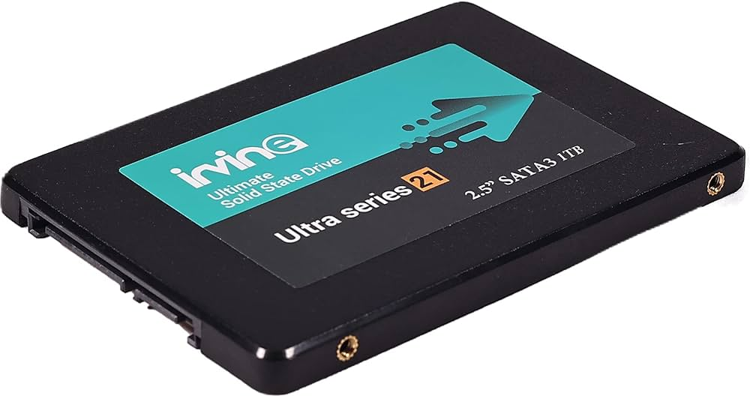
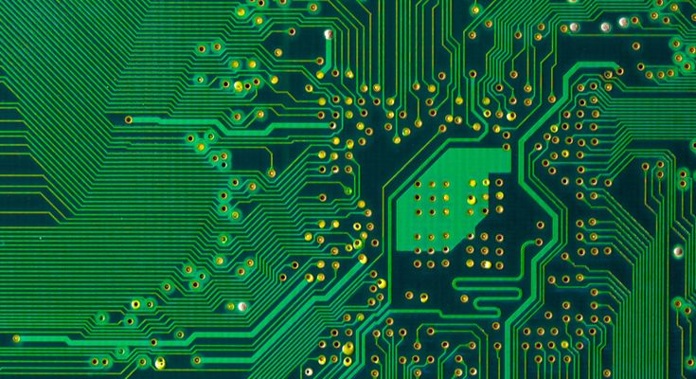
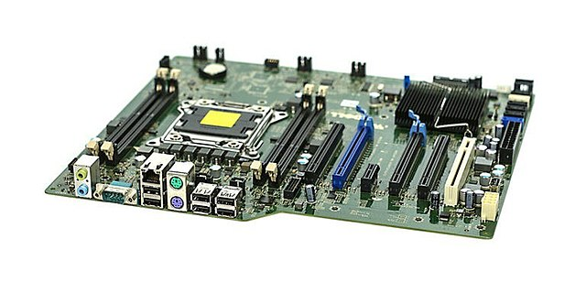
Technology of main functional unit:
Semiconductor Technology
Transistor as basic element in CPU Design
Signal level: 2 levels (On-OFF)
High – Low (Binary- Digital)
Arithmetic Operations in Binary
Data Representation in Binary
Program Representation in Binary
Digital computer

Slide 9
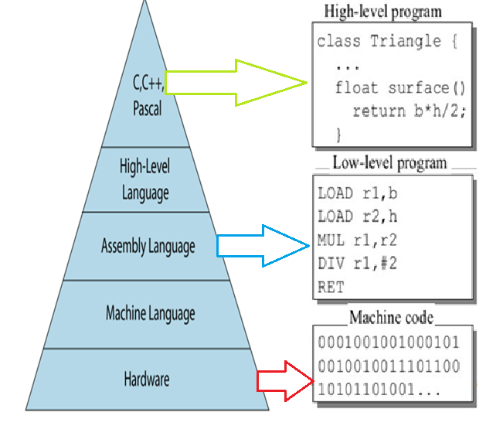
Computer, software, program and Instruction
CPU and Hardware is designed to perform a fixed number of very simple and elementary operations (arithmetic/logical/data transfer operation), such as addition of two number, compare two numbers, shift bits left or right, complement etc.
To do a particular simple and elementary operation, a command is formed in binary and given to CPU and hardware, called Instruction.
Command/instruction in binary is called Machine code. A machine code specifies operation, data or whereabouts data and where to store result.
A program is a sequence of instructions arranged to solve a mathematical, scientific computation of data processing of different types.
Software is a set of computer programs

Slide 10
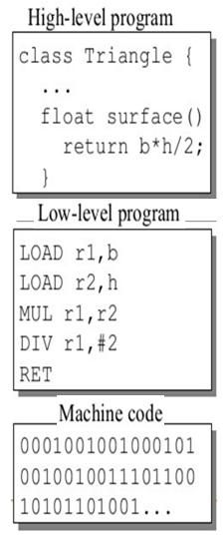
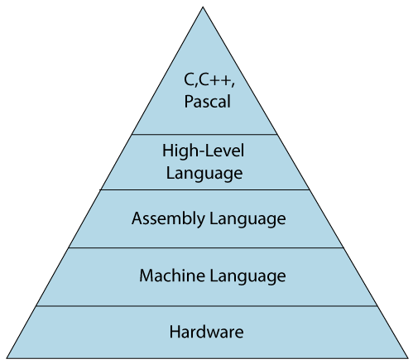
Levels of Program code
We write programs in high-level languages without thinking about on what machine our program will run.
Electronics of the CPU and computer recognize binary representations of instructions. That means each CPU has its own machine language that it understands.

Slide 11
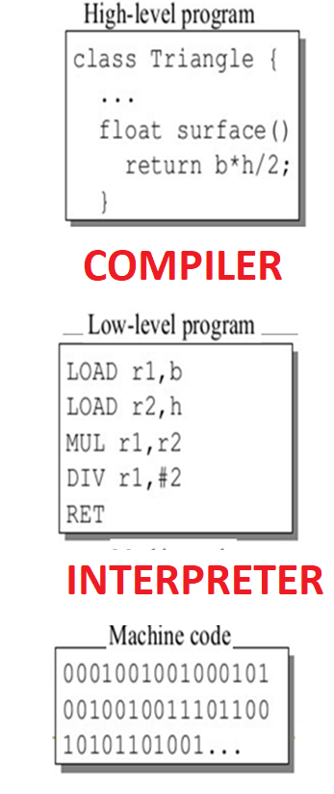
Programs are typically written in higher-level languages and then translated into machine language (executable code).
A compiler is a program that translates code written in one language into another language.
An interpreter translates the instructions one line at a time into something that can be executed by the computer’s hardware.

Slide 12
Digital Computers
Program
Data
Commands
Represented, stored, processed, transferred in Binary:
0 1 0 1 0 0 1 1 (logical)
+3V / +5V
3V / -5V /0V
On / Off switches (Transistors)

Slide 13
Representing computer Architecture: Layers of abstraction
Use layers of abstraction to hide details of the computer design.
We can work in any layer, not needing to know how the lower layers work or how the current layer fits into the larger system.
transistors
gates
circuits (adders, multiplexors … )
central processing units (ALU, registers …)
computer
A component at a higher abstraction layer uses components from a lower abstraction layer without having to know the details of how it is built.
It only needs to know what it does.

Slide 14
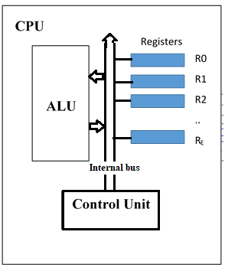
Components of the CPU: brain to coordinates activities
Registers – high speed electronic storage to hold binary data currently being processed or to be processed next
Arithmetic Logic Unit (ALU) – Basic Arithmetic and Logical operations: only two/one data at a time. Addition, subtraction, AND, OR, Rotate bits etc
Control Unit – This contains the logic circuitry controlling the other parts of the CPU.

Slide 15
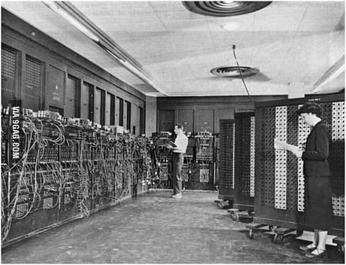
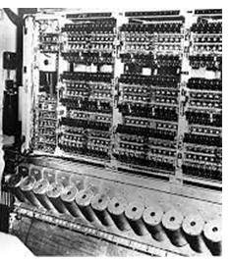
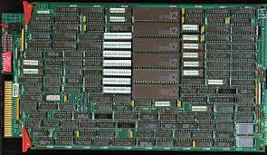
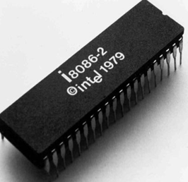
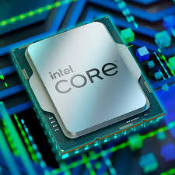
CPU / Microprocessor / Processor
Back in the old days, a CPU consisted of many different separate electronic circuits or chips connected together. So for example, the CPU registers might be on one (or more) chips, the Arithmetic Logic Unit might be another chip.
Microprocessor is an Integrated Circuit (IC) that contains all functional units of a CPU. Nowadays all CPUs are Microprocessors.

Slide 16
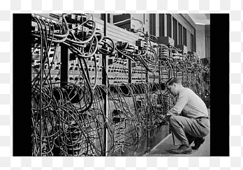
ENIAC (Electronic Numerical Integrator and Computer)
First programmable, electronic, general-purpose digital computer.
Task of taking a problem and feed it onto the machine was complex, and usually took weeks.
After the program was figured out on paper, the process of getting the program into ENIAC by manipulating its switches and cables could take days.
Although ENIAC was designed and primarily used to calculate artillery firing tables for the United States Army's Ballistic Research Laboratory (which later became a part of the Army Research Laboratory),its first program was a study of the feasibility of the thermonuclear weapon.
ENIAC was completed in 1945 and first put to work for practical purposes on December 10, 1945

Slide 17
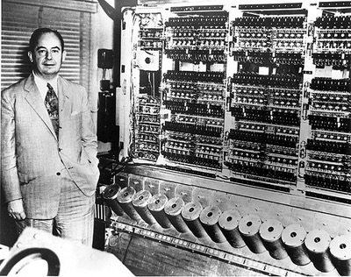
EDVAC (Electronic Discrete Variable Automatic Computer)
It was binary rather than decimal, and was designed to be a stored-program computer.
Functionally, EDVAC was a binary serial computer with automatic addition, subtraction, multiplication, programmed division and automatic checking with an ultrasonic serial memory capacity of 1,000 words.
EDVAC's average addition time was 864 microseconds and its average multiplication time was 2,900 microseconds.
EDVAC was designed to receive its instructions electronically; moreover, the program, coded in zeros and ones, would be kept in the same place that held the numbers the computer would be processing. This approach—letting a program treat its own instructions as data—offered huge advantages.

Slide 18
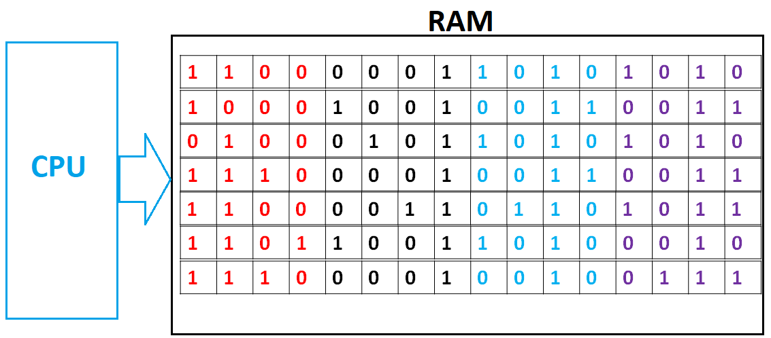
Stored program computer: This was the storing of the program in the same memory as the data. It has been followed by the great majority of all computers ever made since.
Primary memory is fast, but volatile – it loses all information stored in it when the power goes off. Primary memory is primarily RAM (Random Access Memory).

Slide 19
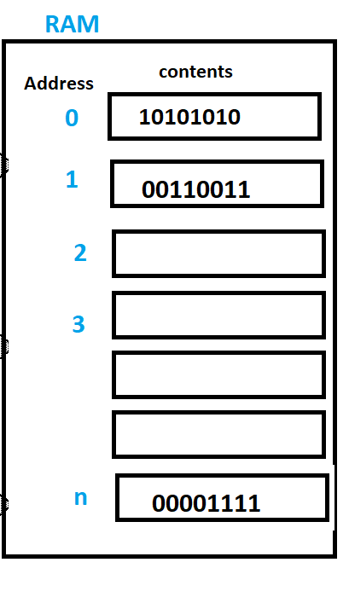

Slide 20
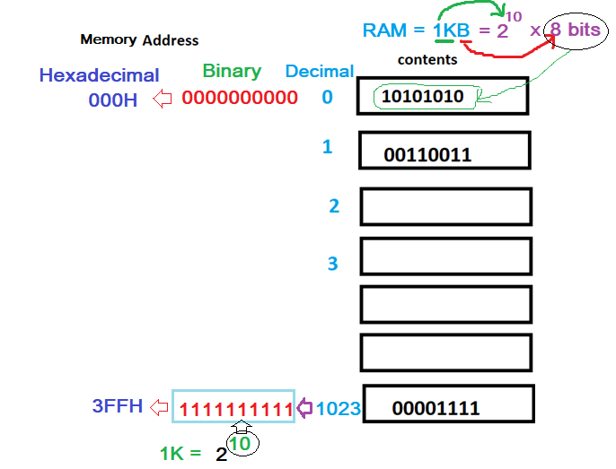
Memory Address
Unique codes used by the programmer to identify locations for data read and write from/to RAM in low-level language
Unique codes used by the CPU to identify locations for data read and write from/to RAM
For 1KB RAM
No of locations = 1024
Contents of each location = 8 bits
8 bits = 1 Byte
1KB is a byte addressable Memory

Slide 21
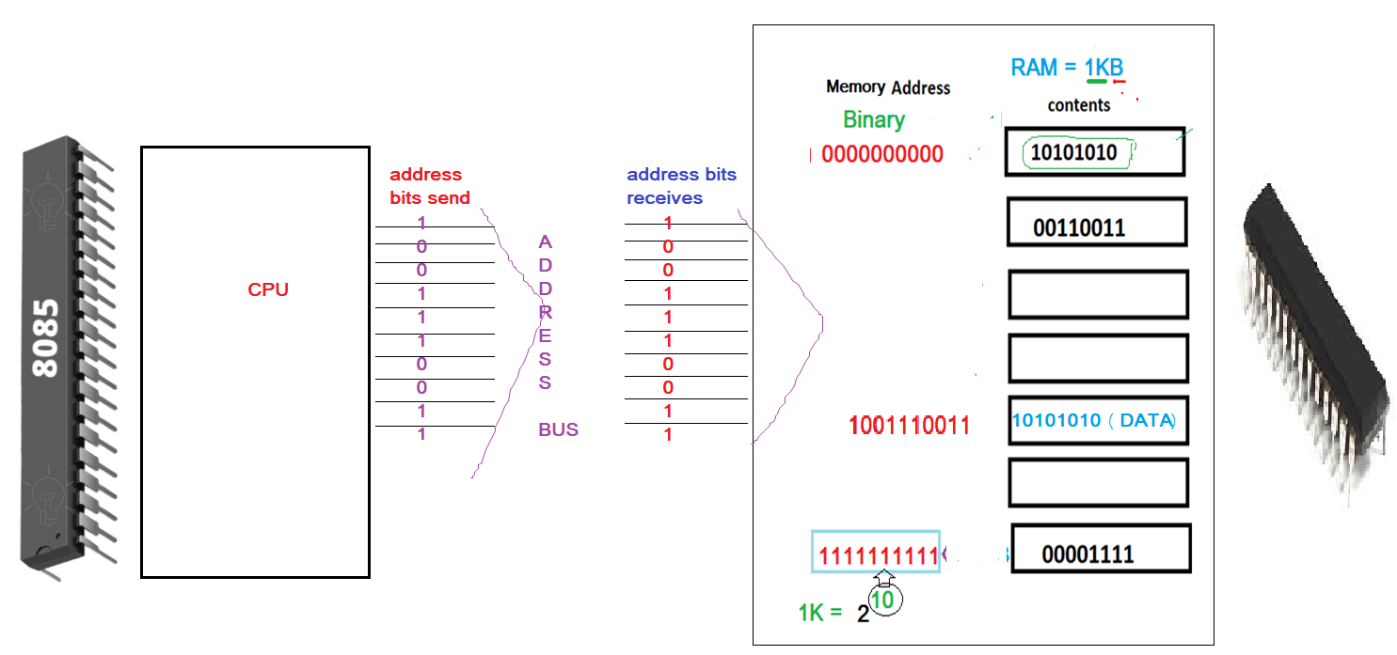

Slide 22
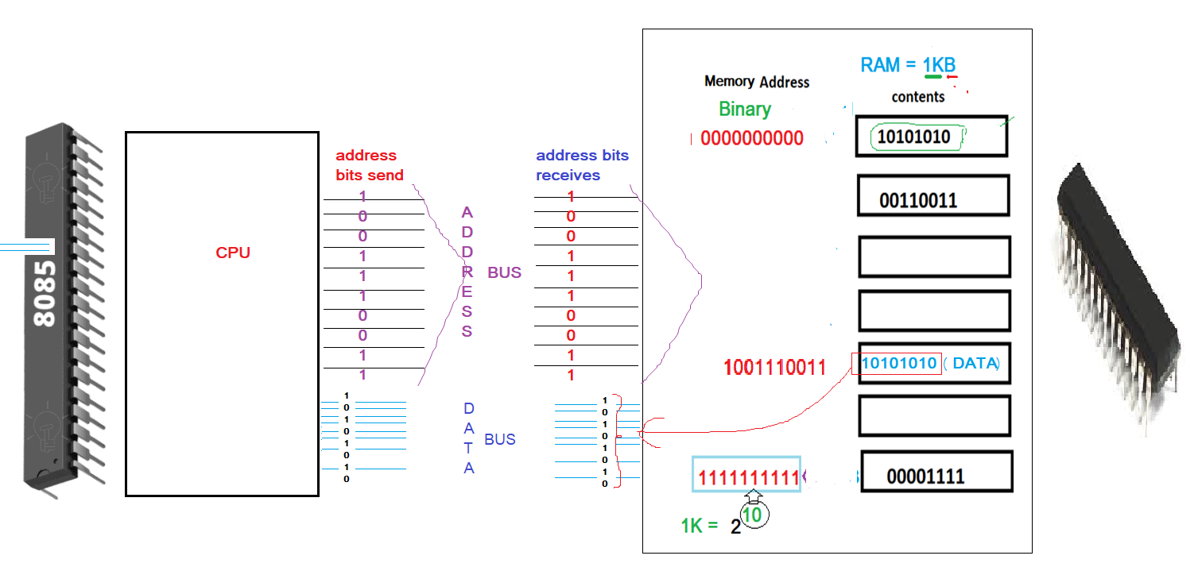

Slide 23
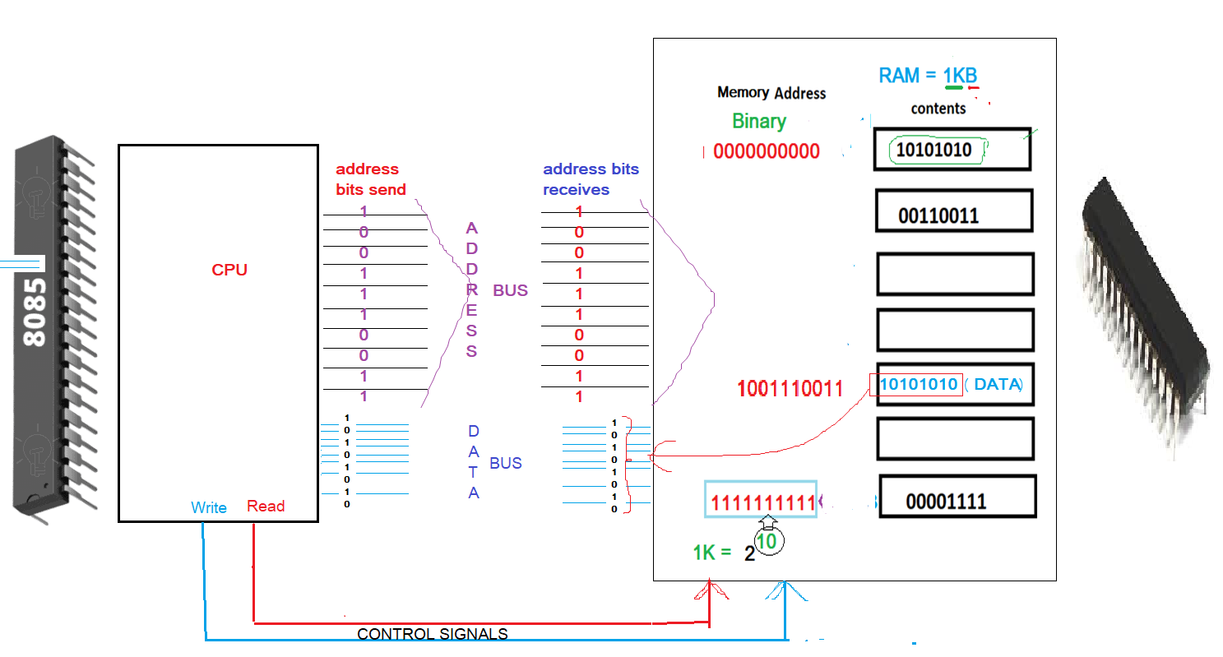

Slide 25
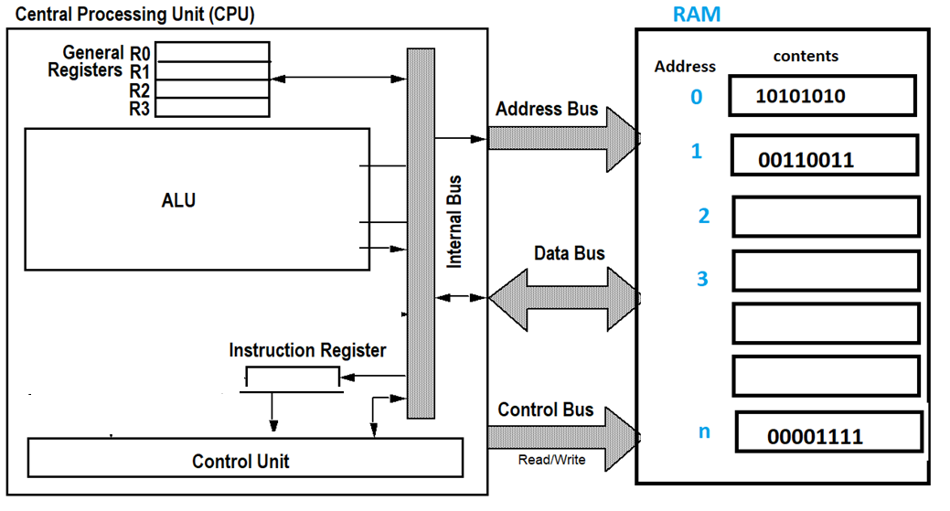
Memory: part of the computer where programs and data are stored
Memory consists of a number of sequential storage locations
Each memory location is capable of storing one data element or one computer instruction

Slide 27
What is a Byte addressable Memory?
Content of each location is 8 bit
Content of each addressable location is 8 bit

Slide 28
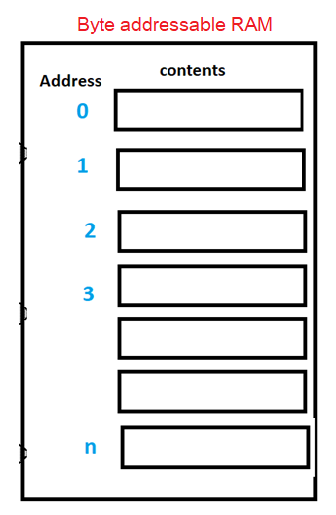
How 16 bits data are stored in a Byte addressable RAM?
11110000 10101010

Slide 29
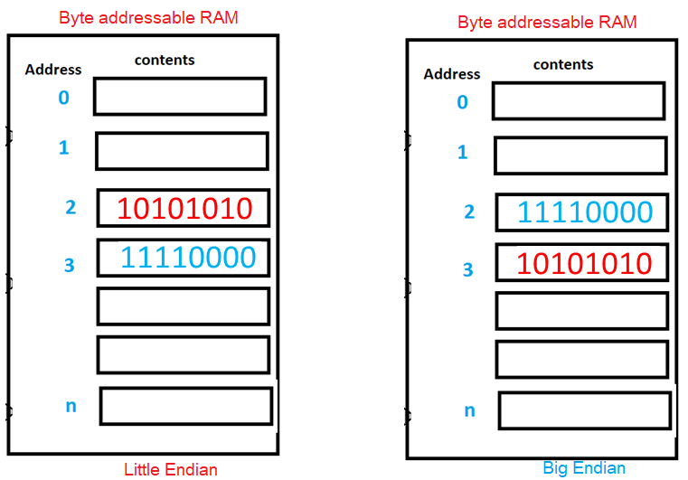
How 16 bits data are stored in a Byte addressable RAM? Example: 11110000 10101010

Slide 30
How 32 bits data are stored in a Byte addressable RAM?
Example: 00001111 10101010 11001100 01010101

Slide 31
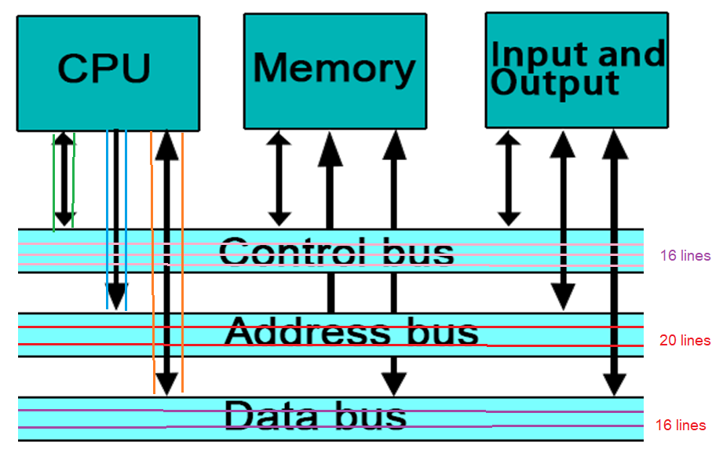

Slide 32
Bus system
Data bus
Size: No of lines: decides no of bits transferred at a time (CPU to/from RAM)
Which one is better: 8 bit data bus or 16 bit data bus or 32 bit data bus
Signal flow is bidirectional
RAM to CPU (during read operation): Input with respect to CPU
and
CPU to RAM (during write operation): Output with respect to CPU
Address bus
Size: No of lines: defines the capacity of RAM
If address bus is 20 bits, what is the capacity of RAM to be used with CPU
Signal flow: always from CPU to RAM: Output with respect to CPU
Control bus
Size: No of functions: defines the functions a CPU can perform
Examples of control signals: READ, WRITE, RESET, INTERRUPT
Some control signals are Input to CPU
Some control signals are output with respect to CPU
Some are bidirectional

Slide 33
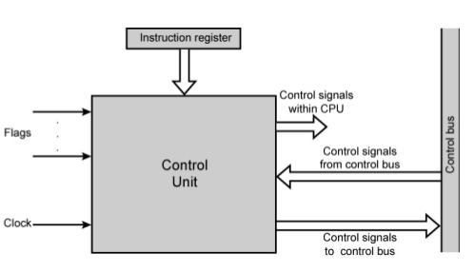
Control Unit
The control unit (CU) is a component of a computer's central processing unit (CPU) that directs the operation of the processor. It tells the computer's memory, arithmetic logic unit and input and output devices how to respond to the instructions that have been sent to the processor.
The control unit of the central processing unit regulates and integrates the operations of the computer. It selects and retrieves instructions from the main memory in proper sequence and interprets them so as to activate the other functional elements of the system at the appropriate moment.
A control Unit (programs are decoded into electronic signals and electronic control and implementation of all other sections

Slide 35
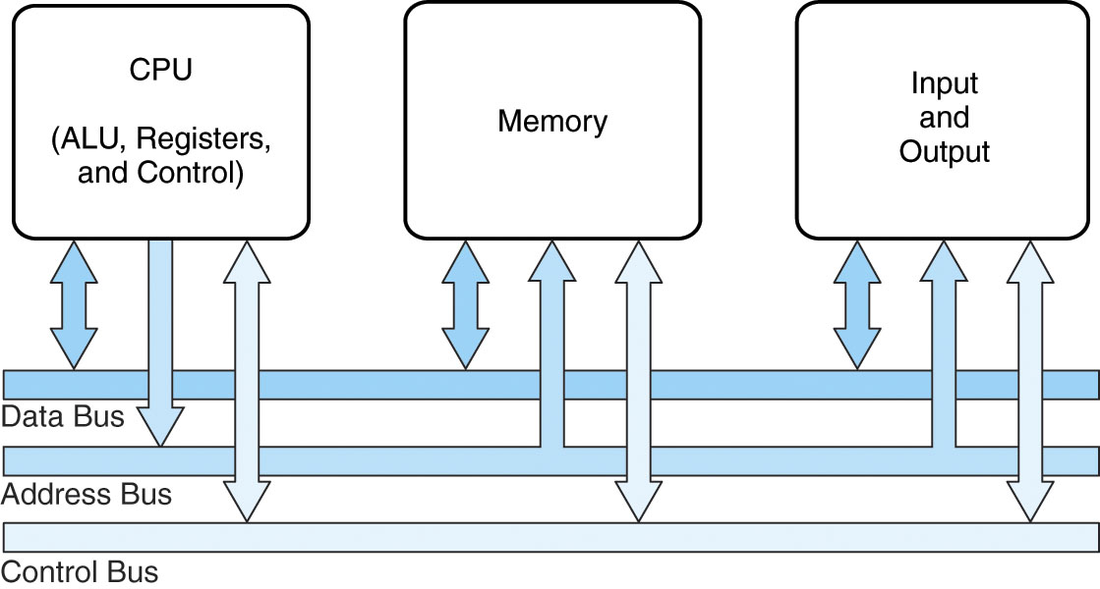

Slide 39
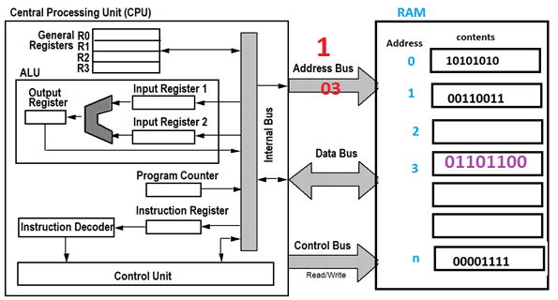
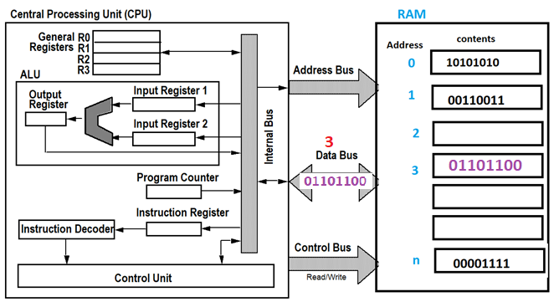
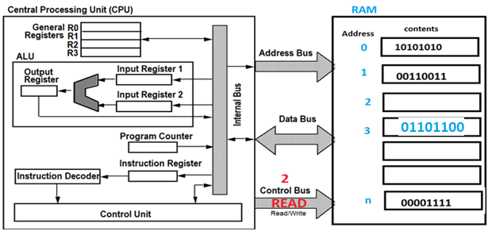
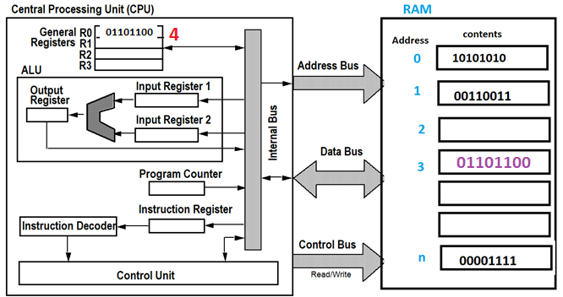
Read operation: Content of a RAM is copied in a Register

Slide 40
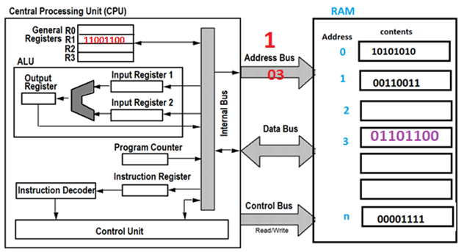
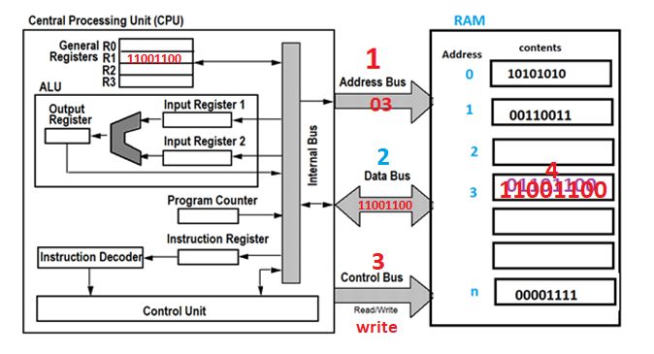
Write operation: Content of a Register is copied to a location of RAM

Slide 41
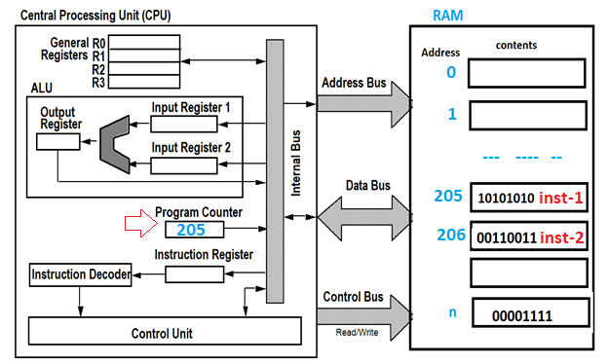
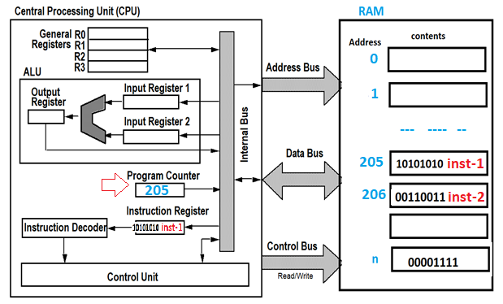
How does CPU run a program? How does CPU process a single Instruction?
The CPU executes an instructions in the following series of steps
The Program Counter (PC) is a special register that holds the address of the 1st instruction to be fetched from Memory
Read/Fetch 1st instruction from memory
Move instruction into instruction register

Slide 42
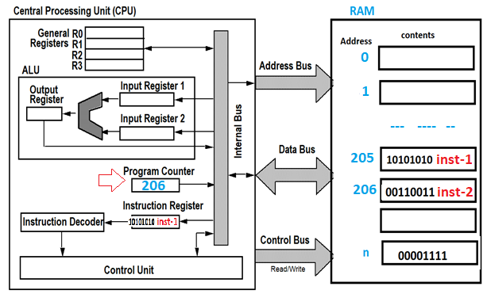
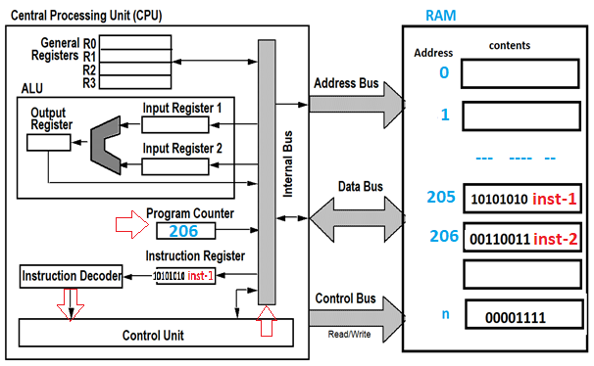
How does CPU run a program? How does CPU process a single Instruction?
The CPU executes an instructions in the following series of steps
Increment/Change program counter to point to next instruction
Decode instruction at Control Unit

Slide 43
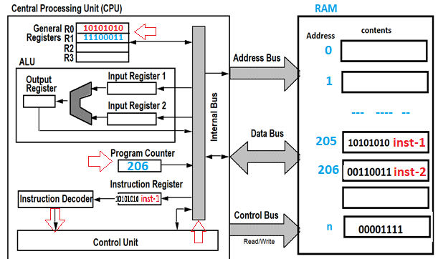
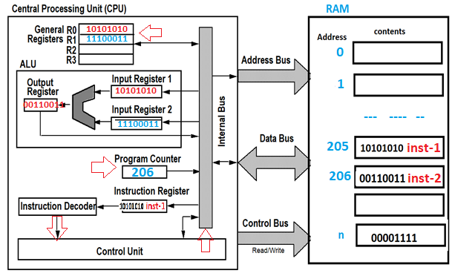
How does CPU run a program? How does CPU process a single Instruction?
The CPU executes an instructions in the following series of steps
If required, read data from RAM and store into internal CPU registers
Perform ALU operation at ALU
Store result to a register
Repeat steps…..for next instruction

Slide 46
Computer Organization & Computer Architecture
Computer Organization
Design of the components and functional blocks using which computer
systems are built.
– Analogy: civil engineer’s task during building construction (cement,
bricks, iron rods, and other building materials).
Computer Architecture
How to integrate the components to build a computer system to
achieve a desired level of performance.
– Analogy: architect’s task during the planning of a building (overall
layout, floorplan, etc.).

Slide 47
Computer Architecture
Computer Organization
Data types
Program (Instruction set)
Input/Output mechanisms
Techniques for addressing memory.
Hardware details
Interfaces between the computer and peripherals
Memory technology

Slide 48
Computer Architecture | Computer Organization
Architecture describes what the computer does. | The Organization describes how it does it.
Computer Architecture deals with the functional behavior of computer systems. | Computer Organization deals with a structural relationship.
In the above figure, it’s clear that it deals with high-level design issues. | In the above figure, it’s also clear that it deals with low-level design issues.
Architecture indicates its hardware. | Where Organization indicates its performance.
As a programmer, you can view architecture as a series of instructions, addressing modes, and registers. | The implementation of the architecture is called organization.
For designing a computer, its architecture is fixed first. | For designing a computer, an organization is decided after its architecture.
Computer Architecture is also called Instruction Set Architecture (ISA). | Computer Organization is frequently called microarchitecture.
Computer Architecture comprises logical functions such as instruction sets, registers, data types, and addressing modes. | Computer Organization consists of physical units like circuit designs, peripherals, and adders.
The different architectural categories found in our computer systems are as follows: Von-Neumann Architecture Harvard Architecture Instruction Set Architecture Micro-architecture System Design | CPU organization is classified into three categories based on the number of address fields: Organization of a single Accumulator. Organization of general registers Stack organization
It makes the computer’s hardware visible. | It offers details on how well the computer performs.
Architecture coordinates the hardware and software of the system. | Computer Organization handles the segments of the network in a system.
The software developer is aware of it. | It escapes the software programmer’s detection.
Examples- Intel and AMD created the x86 processor. Sun Microsystems and others created the SPARC processor. Apple, IBM, and Motorola created the PowerPC. | Organizational qualities include hardware elements that are invisible to the programmer, such as interfacing of computer and peripherals, memory technologies, and control signals.

Slide 49
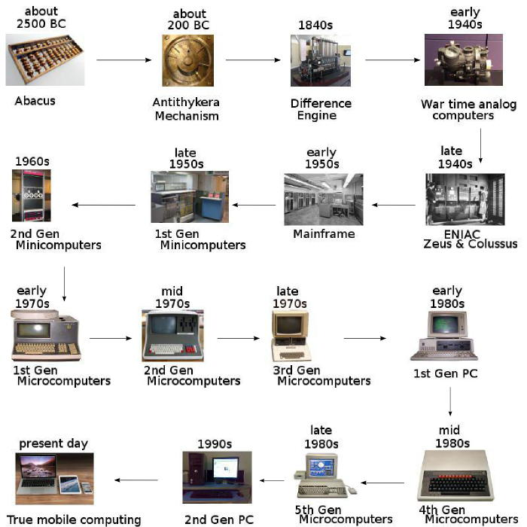
Evolution of Computers

Slide 50
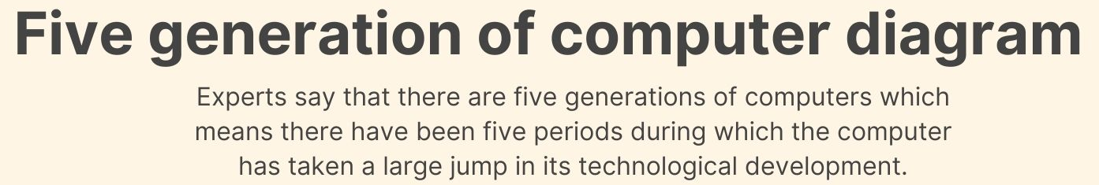
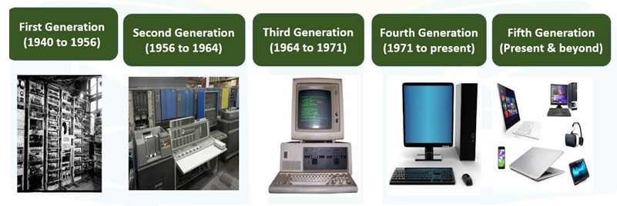
Generation in computer terminology is a change in technology a computer is/was being used. Initially, the generation term was used to distinguish between varying hardware technologies. Nowadays, generation includes both hardware and software, which together make up an entire computer system.

Slide 51
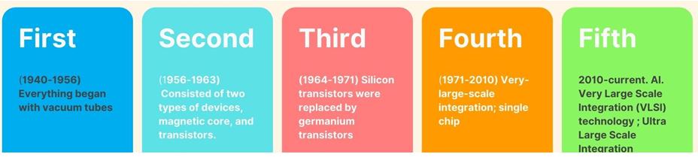
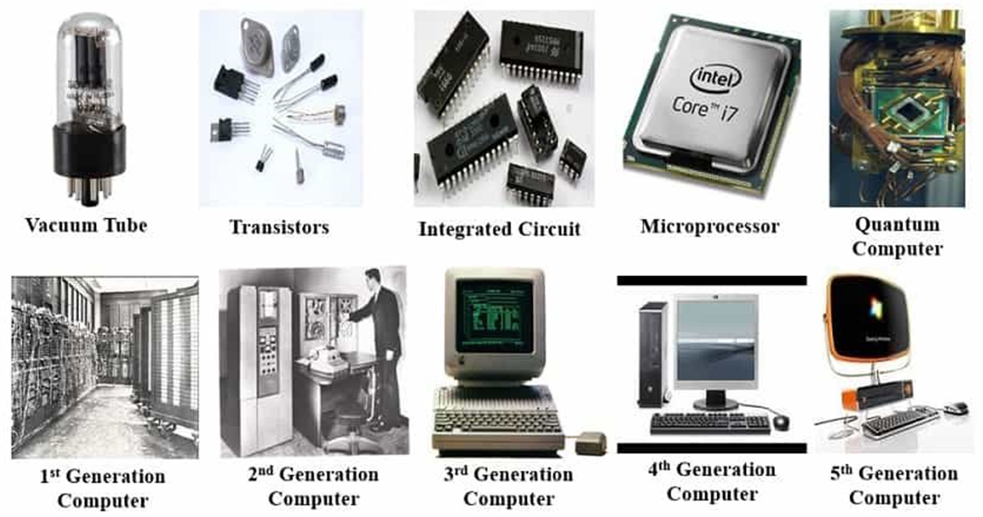

Slide 52
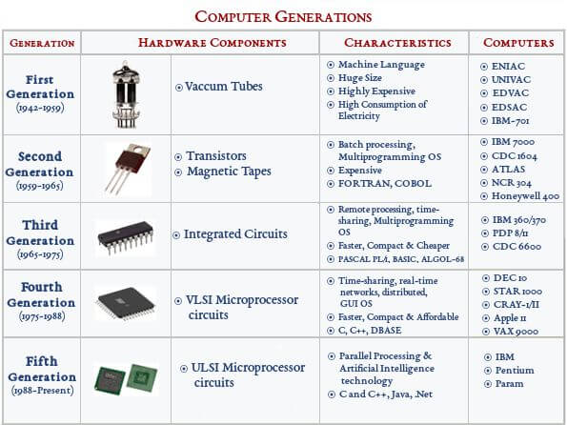

Slide 53





Analog vs Digital

Slide 54

An analog computer or analogue computer is a type of computer that uses the continuous variation aspect of physical phenomena such as electrical, mechanical, or hydraulic quantities (analog signals) to model the problem being solved. In contrast, digital computers represent varying quantities symbolically and by discrete values of both time and amplitude (digital signals). Analog computers were widely used in scientific and industrial applications even after the advent of digital computers, because at the time they were typically much faster, but they started to become obsolete as early as the 1950s and 1960s, although they remained in use in some specific applications, such as aircraft flight simulators, the flight computer in aircraft, and for teaching control systems in universities.
A 1960 Newmark analogue computer, made up of five units. This computer was used to solve differential equations and is currently housed at the Cambridge Museum of Technology.

Slide 55

ENIAC: Two professors at the University of Pennsylvania, John Mauchly and J. Presper Eckert, design and build the Electronic Numerical Integrator and Calculator (ENIAC). The machine is the first "automatic, general-purpose, electronic, decimal, digital computer

Slide 56

1981: "Acorn," IBM's first personal computer, is released onto the market at a price point of $1,565, according to IBM. Acorn uses the MS-DOS operating system from Windows. Optional features include a display, printer, two diskette drives, extra memory, a game adapter and more.

Slide 57
ENIAC (Electronic Numerical Integrator and Computer)
First programmable, electronic, general-purpose digital computer.
Task of taking a problem and feed it onto the machine was complex, and usually took weeks.
After the program was figured out on paper, the process of getting the program into ENIAC by manipulating its switches and cables could take days.
Although ENIAC was designed and primarily used to calculate artillery firing tables for the United States Army's Ballistic Research Laboratory (which later became a part of the Army Research Laboratory),its first program was a study of the feasibility of the thermonuclear weapon.
ENIAC was completed in 1945 and first put to work for practical purposes on December 10, 1945

Slide 58

ENIAC was just a large collection of arithmetic machines, which originally had programs set up into the machine by a combination of plugboard wiring and three portable function tables (containing 1200 ten-way switches each).

Slide 59
EDVAC (Electronic Discrete Variable Automatic Computer)
It was binary rather than decimal, and was designed to be a stored-program computer.
Functionally, EDVAC was a binary serial computer with automatic addition, subtraction, multiplication, programmed division and automatic checking with an ultrasonic serial memory capacity of 1,000 words.
EDVAC's average addition time was 864 microseconds and its average multiplication time was 2,900 microseconds.
EDVAC was designed to receive its instructions electronically; moreover, the program, coded in zeros and ones, would be kept in the same place that held the numbers the computer would be processing. This approach—letting a program treat its own instructions as data—offered huge advantages.

Slide 60


Stored program computer: Von Neumann architecture
Both Instructions and Data are stored in RAM in binary
Instructions (Program) are modified easily
Single RAM holds both Instructions and Data
Single BUS system was used to connect CPU to RAM

Slide 61
von Neumann Architecture
Key Features
Data and instructions are both stored in a single primary storage
Instructions are read from memory one at a time and in order (serially as it is stored/as it appears in a program).
The processor decodes and executes one instruction at a time.
Result is stored
CPU reads next instruction from RAM
This process continues till the end of the program.
Parallel implementation of instructions is not allowed.
Instructions can only be carried out one at a time and sequentially.
CPU cannot read Instruction and data simultaneously due to a single bus system
Limitations: Von Neumann Bottleneck
An instruction read/fetch and a data operation cannot occur at the same time because they share a common bus.
CPU has to wait and remains idle for a certain amount of time while low speed memory is being accessed.
Von Neumann bottleneck limits the performance of the system.

Slide 63




Slide 64


Slide 65

Local bus is a computer bus that connects CPU directly to one or more slots. The significance of direct connection to the CPU is avoiding the bottleneck created by the expansion bus, thus providing fast throughput.
Expansion Bus Types
These are some of the common expansion bus types that have been used in computers:
ISA - Industry Standard Architecture
EISA - Extended Industry Standard Architecture
MCA - Micro Channel Architecture
VESA - Video Electronics Standards Association
PCI - Peripheral Component Interconnect
PCI Express (PCI-X)
PCMCIA - Personal Computer Memory Card Industry Association (Also called PC bus)
AGP - Accelerated Graphics Port
SCSI - Small Computer Systems Interface

